Slide 1
CORE PYTHON
Ken Chen 2012/06/26

Slide 2
Agenda
Basic native data types in python
The python grammar
String, list and tuple
Map and collection
Module
Regular expression
Network programming
Multi-thread
Web programming
Database programming

Slide 3
Basic built-in data object primitive types
Numbers
int/long/bool/float/complex
String (Python has no char type)
‘string embedded in single quote’
“string embedded in double-quota”
‘’’string embedded in triple single quota’’’
“””string embedded in triple double quota”””
List
aList = [1, 2, 3, 4]
Tuple
aTuple = (1, 2, 3, 4)
Dictionary
aDict = {‘key1’: ‘value1’, ‘key2’: ‘value2’}

Slide 4
Basic built-in data object primitive types (Cont.)
Numbers
Can’t be changed, you change number, actually new number is created
Factory methods: bool(obj), int(obj, base=10), long(obj, base=10), float(obj), complex(str) etc
String
Can’t be changed as numbers, you change string, actually new string is created
Single quota and double quota are the same in Python
You can separate multiple lines in triple single/double quotas
Factory method: str(obj), unicode(obj)
Difference between List and tuple
List is mutable, factory method: list(iter)
Tuple is immutable, factory method: tuple(iter)
dict() is factory method for dictionary

Slide 5
Other Basic built-in data object primitive types
Built-in types
Type (type, say type(42))
Null object (None)
File
Set/FrozenSet
Function/Method
Module
Class
Internal Types
Code: compile()
Frame
Traceback
Slice: slice()
Ellipsis
Xrange: xrange

Slide 6
Bool value
The following bool value is False, all other objects are True
None
False (Boolean)
Any numeric zero
0 (integer)
0.0 (float)
0L (long integer)
0.0+0.0j (complex)
"" (empty string)
[] (empty list)
() (empty tuple)
{} (empty dictionary)
For user defined class instance, if it defines nonzero(__nonzero()) or length(__len()) and if they are 0, the instance have False value.

Slide 7
type() and isinstance()
type() returns a ‘type’ object
>>> type('')
<type 'str'>
>>> type(int)
<type 'type'>
>>> type(4)
<type 'int'>
>>> type(0+0j)
<type 'complex'>
>>> type(0L)
<type 'long'>
>>> type(0.0)
<type 'float'>
>>> type([])
<type 'list'>

Slide 8
type() and isinstance() (cont.)
type() cont.
>>> type(())
<type 'tuple'>
>>> type({})
<type 'dict'>
>>> type(type)
<type 'type'>
>>> class Foo: pass
>>> foo = Foo()
>>> type(Foo)
<type 'classobj'>
>>> type(foo)
<type 'instance'>

Slide 9
type() and isinstance() (cont.)
isinstance()
>>> isinstance(4, int)
True
>>> type(4) is types.IntType
True

Slide 10
Factory methods recap
Factory methods which are built-in functions in old days
dict()
bool()/int()/long()/float()/complex()
set()/frozenset
object()
classmethod()
staticmethod()
super()
property()
file()

Slide 11
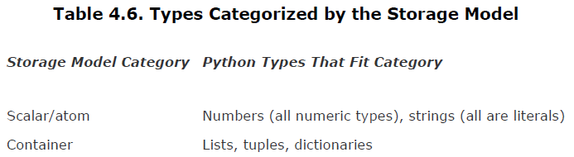
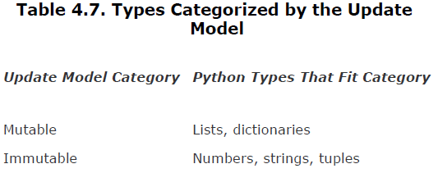
Categorizing Primitive types
Storage Model
Update Model

Slide 12
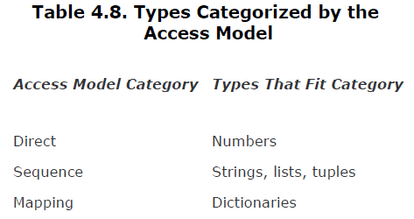
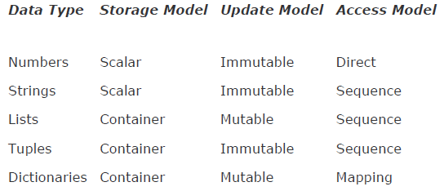
Categorizing Primitive types (Cont.)
Access Model
Summary

Slide 13
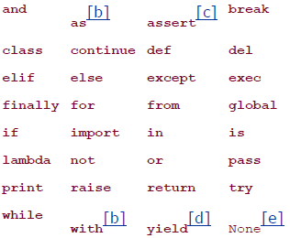
Keywords
Python keyword set
Built-ins
In __builtins__ module, should be treated as reserved words by the system
Special Underscore Identifiers
_xxx Do not import with 'from module import *‘
__xxx__ System-defined name
__xxx Request private name mangling in classes

Slide 14
Grammar
Basic rules and special characters
# - Comments
\n - NEWLINE, standard line separator
\ - Continues a line
; - Joins two statements on a line
: - Separate a header line from its suite
Code blocks are grouped as suites (must identical indented)
Suites delimited via indentation
Python files organized as modules
Variable Assignment
anInt = 12
aString = ‘cart’
aFloat = -3.14
aList = [1, 2, 3, 4]
aTuple = (1, 2, 3, 4)
aComplex = 1 + 2j
x, y ,z = 1, 2, ‘a string’ but (x, y, z) = (1, 2, ‘a string’) is preferred

Slide 15
Grammar - Conditions and loops
If statement
if expression1: statement1 elif expression2: statement2 else: statement3
The ternary operator
X if C else Y
smaller = (x if x < y else y)
While
while expression: suite_to_repeat

Slide 16
Grammar - Conditions and loops
For statement
for iter_var in iterable: suite_to_repeat
Used with sequence type: for eachLetter in ‘hello world’: print eachLetter
Used with iterator type for cnt in range(2, 5): print cnt
continue/break
pass - nop
while/else, for/else, else is executed when while/for run to end
While expression: suite_to_repeat else: statements

Slide 17
Grammar - Conditions and loops
while/else, for/else, else is executed when while/for run to end
While expression: suite_to_repeat else: statements
Iterator and iter()
Iterator object has next() method
iter() creates iterator object iter(obj), iter(func, sentinel)
Use iterator coz better performance/extensible interface/more readable code

Slide 18
Grammar - Conditions and loops
Iterator and iter() (cont.)
for i in seq: do_sth_to(i) equals fetch = iter(seq) while True: try: i = fetch.next() except: break do_sth_to(i)
File is iterable
myFile = open(‘test.txt’) for eachLine in myfile: print eachLine, # comma supresses extra \n

Slide 19
Grammar - Conditions and loops
Dictionary is iterable
legends = {('Poe', 'author'): (1809, 1849, 1976), ('Gaudi', 'architect'): (1852, 1906, 1987), ...} for eachLegend in legends: print 'Name: %s\tOccupation: %s' % eachLegend print ' Birth: %s\tDeath: %s\tAlbum: %s\n' \ % legends[eachLegend]

Slide 20
Grammar - Exception
try/except (exception)
try: try_suite except Exception1 [, reason1]: except_suite1 except (Exception3, Exception4, …) [, reason]: except_suite3 … else: else_suite finally: final_suite
Else suite will be executed if No exception is raised in try_suite
Finally suite is always granted to be executed

Slide 21
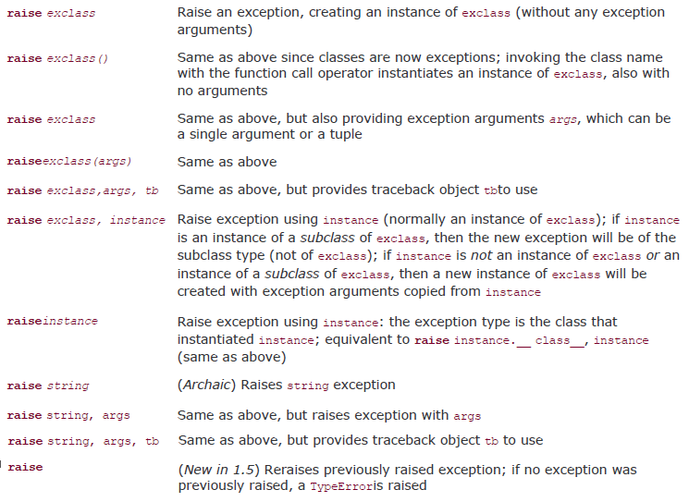
Grammar - Exception
raise (exception)
rasie [SomeException [, args [, traceback]]]

Slide 22
Grammar - Exception
assert
assert expression [, arguments]
Create exception class
class FileError(IOError): pass

Slide 23
Grammar - Function
Function
def function_name (arguments): “function_documentation_string” function_body_suite
Default arguments are supported def default_arg (i, j = 0)
Positional arguments are supported when calling function default_arg(j = 3, i = 4)
Grouped Arguments are supported allows to execute a function without explicitly specifying individual arguments in the call as long as grouped the arguments in either a tuple (non-keyword arguments) or a dictionary (keyword arguments). func(*tuple_grp_nonkw_args, **dict_grp_kw_args)
Embedded functions are supported

Slide 24
Grammar - Function
Non-keyword Variable Arguments - Tuple
def function_name ([formal_args,] *vargs_tuple): “function_documentation_string” function_body_suite def tupleVarArgs(arg1, arg2 = ‘defaultB’, *theRest) print ‘format arg 1:’, arg1 print ‘format arg 2:’, arg2 for eachXtrArg in theRest: print ‘another arg:’, eachXtrArg tupleVarArgs(‘abc’) tupleVarArgs(23, 34) tupleVarArgs(‘abc’, 123, ‘xyz’, 456.78)

Slide 25
Grammar - Function
Keyword Variable Arguments – Dictionary
def function_name ([formal_args,] [*vargs_tuple,] **vargsd): “function_documentation_string” function_body_suite def dictVarArgs(arg1, arg2 = ‘defaultB’, **theRest) print ‘format arg 1:’, arg1 print ‘format arg 2:’, arg2 for eachXtrArg in theRest.keys(): print ‘Xtra arg %s: %s’, %(eachXtrArg, str(theRest[eachXtrArg])) dictVarArgs(arg2=‘tales’, c=123, d=‘poe’, arg1=‘mystery’) dictVarArgs(‘one’, d=10, e=‘xyz’, men=(‘freud’, ‘gaudi’))
Non-Keyword variable args Must be the last arg if there is no Keyword variable args, otherwisethe keyword variable args will be the last arg, and non-keyword variable arg will proceed it.

Slide 26
Grammar - Function
Calling variable arguments
def newfoo(arg1, arg2, *nkw, **kw) print “arg1 is: ”, arg1 print “arg2 is: ”, arg2 for eachNKW in nkw: print ‘additional non-keyword arg: ’, eachNKW for eachKW in kw.keys(): print “additional keyword arg ‘%s’: %s” %(eachKW, kw[eachKW]) newfoo(2, 4, *(6, 8), **{‘foo’: 10, ‘bar’: 12}) aTuple = (6, 7, 8) aDict = {‘z’ : 9} newfoo(1, 2, 3, x = 4, y=5, *aTuple, **aDict)

Slide 27
Grammar - Function
Decorator
@decorator(dec_opt_args) def func2Bdecorated(func_opt_args)
decorator is a function in fact
Decorator can be stacked @deco2 @deco1 def func(arg1, arg2, …): pass equals func = deco2(deco1 (func))

Slide 28
Grammar - Function
Create decorator
def tsfunc (args): def post_logged(f) def wrappedFunc(*args, **kargs):
print "%s() called, args: %r, kargs: %r" %(f.__name__, args, kargs)
return f(*args, **kargs)
return wrappedFunc
print args
return post_logged ⬅ Must return a func which takes the decorated func as the arg
@tsfunc("decorator_args")
def foo(name):
print "foo %s" %(name)
foo("hello")

Slide 29
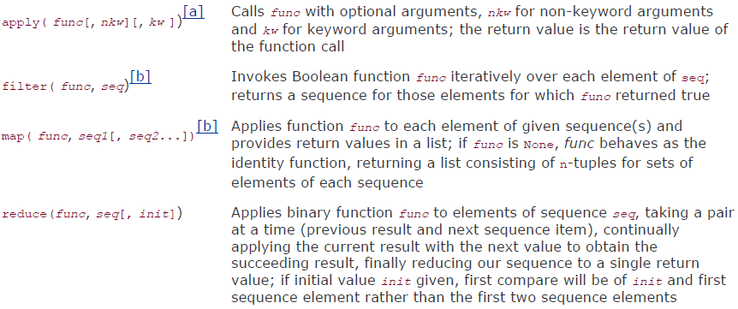
Grammar - Function
Lamba
lambda [arg1[, arg2, ... argN]]: expression lambda x, y: x + y
apply/filter/map/reduce

Slide 30
Grammar - Function
Partial Function Application
A function taking N arguments that is "curried" embalms the first argument as a fixed parameter and returns another function object taking (the remaining) N-1 arguments
Something like ‘bind’ feature in C++
Note: the fixed arguments are always placed to the left of the runtime arguments
Example
from operator import add, mul from functools import partial add1 = partial(add, 1) # add1(x) == add(1, x) mul100 = partial(mul, 100) # mul100(x) == mul(100, x) add1(10) mul100(10)
baseTwo = partial(int, base=2)
baseTwoBAD = partial(int, 2) ⬄ Wrong!!!

Slide 31
Grammar - Function
Variable Scope
Local variable will hide global variable. Python search order is from local (function) to global (outside function) global_str = 'foo‘ def foo(): local_str = 'bar‘ return global_str + local_str
Use “global” to reference the global variable inside the function global var1[, var2[, ... varN]]] is_this_global = 'xyz‘ def foo(): global is_this_global is_this_global = 'def‘ …

Slide 32
Grammar - Function
Closure
If references are made from inside an inner function to an object defined in any outer scope (but not in the global scope), the inner function then is known as a closure
The variables defined in the outer function but used or referred to by the inner function are called free variables def counter(start_at=0): count = [start_at] def incr(): count[0] += 1 return count[0] return incr
Closure Lexical Variables
Can track down free variables with a function's func_closure attribute
print “f closure vars:", [str(c) for c in f.func_closure]

Slide 33
Grammar - Function
Generator
Coroutine is an independent function call that can run, be paused or suspended, and be continued or resumed where it left off. There is also communication between the caller and the (called) coroutine
Coroutines that are suspended yielding intermediate values and resumed multiple times are called generators, and that is exactly what Python generators do
Generators can yield control while waiting for a generator it has called to yield a result instead of blocking to wait for that result to come back before the calling generator can suspend (and yield a result)
Syntactically, a generator is a function with a yield statement
Need import __future__ module to use it
Useful when iterating the large data/database, grab some data, process it and then grab another piece of data …

Slide 34
Grammar - Function
Generator (Cont.)
from random import randint def randGen(aList): while len(aList) > 0: yield aList.pop(randint(0, len(aList))) for item in randGen(['rock', 'paper', 'scissors']): print item
Enhanced Generator Features
[send()], send values back into generators
[tHRow()], raise exceptions in generators
[close()], request that a generator quit

Slide 35
Grammar - Function
Generator (Cont.)
def counter(start_at=0): print ‘not executed until the first next/send is called’ count = start_at while True: val = (yield count) ⬅ Must be an expression to receive data if val is not None: count = val else: count += 1
count = counter(5) //don’t print anything, image returns a special obj count.next() // start to execute until hitting the yield statement, and // returns the value after the yield keyword which is 5 count.send(9) // resume executing from where the last yield, changes // the yield expression value to 9 count.next() count.close() count.next()

Slide 36
Grammar - Class
Class Definition
class MyClass(bases): ‘define MyClass doc’ def __init__(self, args…) # init function, like constructor in C++ base.__init__(self, args…) # call parent __init__ if necessary self. foo = arg1 # instance variable foo = xxx # class property (variable, like static in C++) def instanceMethod(self, args…): pass @staticmethod def staticMethod(args…): pass @classmethod # Need class (object) passed as the first arg def classMethod (cls): pass

Slide 37
Grammar - Class
Access class/instance properties
# __init__ is called automatically, self is also passed in automatically myClassInstance = MyClass() # access instance var, hide the class foo property myClassInstance.foo # access class var MyClass.foo # access instance method myClassInstance.instanceMethod(…) # access classMethod MyClass.classMethod(…)

Slide 38
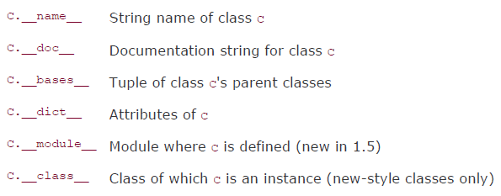
Grammar - Class
Special class properties
C.__dict__
Consists of a dictionary containing the data attributes of a class. When accessing a class attribute, this dictionary is searched for the attribute in question. If it is not found in __dict__, the hunt continues in the dictionary of base classes, in "depth-first search" order set of base classes is searched in sequential order, left-to-right in the same order as they are defined as parent classes in a class declaration. Modification of a class attribute affects only the current class's dictionary; no base class __dict__ attributes are ever modified

Slide 39
Grammar - Class
static methods and class methods
Use @staticmethod/@classmethod to decorators define
Or use staticmethod()/classmethod() traditional function to define class TestClassMethod: def foo(cls): pass foo = classmethod(foo)
Pay attention to use instance to access immutable class properties
Class Foo(object): x = 1.5 # integer is immutable … foo = Foo() foo.x = 1.7 # try to update class property Foo.x => 1.5 # class property is not changed, instead new property x # (which is 1.7) is added to instance foo, and use # instance to access class property will hide class prop…

Slide 40
Grammar - Class
Use instance to access immutable class properties (cont.)
del foo.x # delete instance property foo.x => 1.5 # class property comes back foo.x += 0.2 # try to increase class property, actually foo.x += 0.2 foo.x => 1.7 # equals foo.x = Foo.x + 0.2 Foo.x => 1.5 # class property is not increased !!!
Use instance to access mutable class properties
class Foo(object): x = {2003: ‘poe’} … foo = Foo() foo.x[2004] = ‘valid path’ foo.x => (2003:’poe’, 2004:’valid path’) Foo.x => (2003:’poe’, 2004:’valid path’) # it works… del foo.x # can’t delete class attribute thr instance Traceback…

Slide 41
Grammar - Class
Class properties are shared among all its instances
Use class to access/modify class properties instead of instance
Classes and types were unified in python 2.2, class itself is an object
class MyClass(object): pass mc = MyClass() type(mc) => <class ‘__main.MyClass’> # mc is an instance of MyClass type(0) => <type ‘int’> # 0 is an instance of int type(MyClass) => <type ‘type’> type(int) => <type ‘type’> # both MyClass and int are ‘type’s
Class MyClass: pass # classic class mc = MyClass() type(mc) => <type ‘instance’>

Slide 42

Grammar - Class
Classic class (use 2.1 interpreter)
Class MyClass: pass mc = MyClass() type(mc) => <type ‘instance’> # has no relationship with MyClass type(MyClass) => <type ‘class’>
Special instance properties
Note, I.__dict__ is different than C.__dict, also for the __class__ property

Slide 43
Grammar - Class
Constructor methods
__init()__ : if not defined, use the default, child can override the parent version. Call parent version in child if necessary. It must return ‘None’
__new()__: For subclassing immutable class, say int, string etc. It should call super class __new()__ to create object. It must return a instance object, which then can be consumed by __init()__
Destructor methods
__del()__: ‘del’ operator causes the ref cnt to drop down to 0, it will invoke __del()__ (so called only once)
Pitfalls:
Do not forget to call a superclass __del__() first
Circular referencing will not cause __del()__ called
Uncaught exceptions in __del__() are ignored
Try not to do anything in __del__() not related to an instance

Slide 44
Grammar - Class
Binding and method invoking
Invoking a method against an instance is called that the method is bound to the instance. All non-static, non-class methods should be bound to an instance when invoking.
class MyClass(object): def foo(self): pass mc = MyClass() mc.foo() MyClass.foo(mc)

Slide 45
Grammar - Class
Subclass
class P(object): def __init__(self, i): self.i = i def foo(self): print “P i = %d’, %(i) class C(P): def __init__(self, i, j) P.__init__(self, i) self.j = j def foo(self): # Override the P.foo() print “C j = %d”, %(j)
c = C(1, 2), c.foo() => “C j = 2”, P.foo(c) => “P i = 1”

Slide 46
Grammar - Class
Deriving Standard Types
class RoundFloat(float): def __new__(cls, val): return super(RoundFloat, cls).__new__(cls, round(val, 2)) RoundFloat(1.5955) => 1.6
class SortedKeyDict(dict): def keys(self): return sorted(super(SortedKeyDict, self).keys()) # return sorted(self.keys())

Slide 47
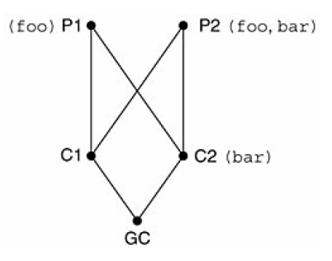
Grammar - Class
Multiple inheritance
Method Resolution Order (MRO) In Python versions before 2.2, the algorithm was simple enough: a depth-first left-to-right search to obtain the attribute to use with the derived class. It has problem (Caused by Diamonds) after classes and types are consolidated in new Python. New algorithm - breadth-first
Classic
gc = GC()
gc.foo() # GC => C1 => P1
gc.bar() # GC => C1 => P1 => P2
New style class
gc.foo() # GC => C1 => C2 => P1
gc.bar() # GC => C1 => C2

Slide 48
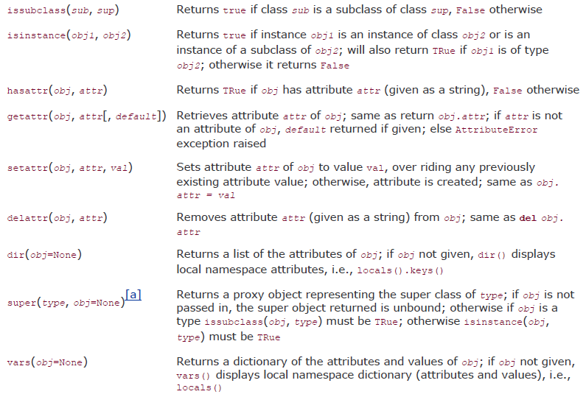
Grammar - Class
Built-in methods for class/instance

Slide 49
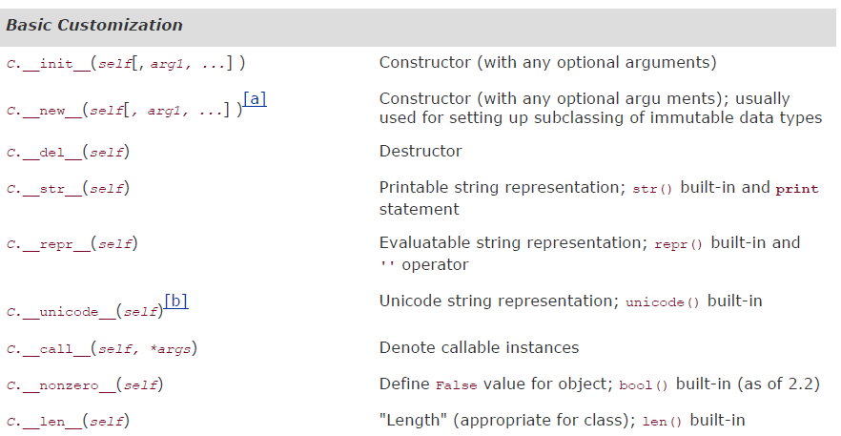
Grammar - Class
Special Methods for Customizing Classes

Slide 50
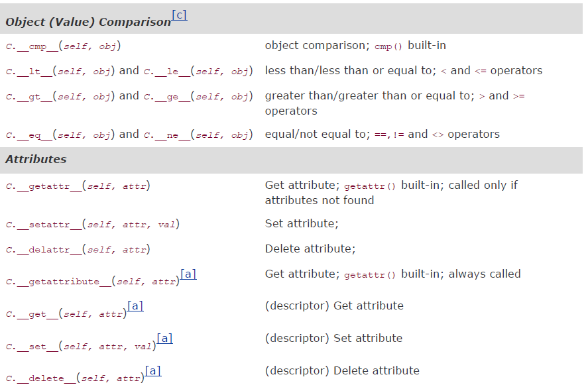
Grammar - Class
Special Methods for Customizing Classes (Cont.)

Slide 51
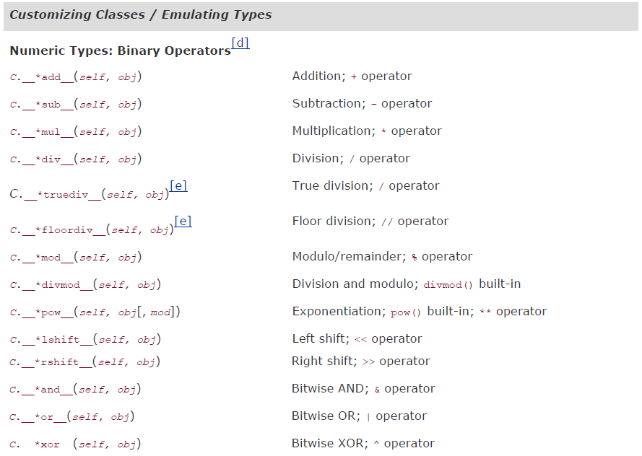
Grammar - Class
Special Methods for Customizing Classes (Cont.)

Slide 52
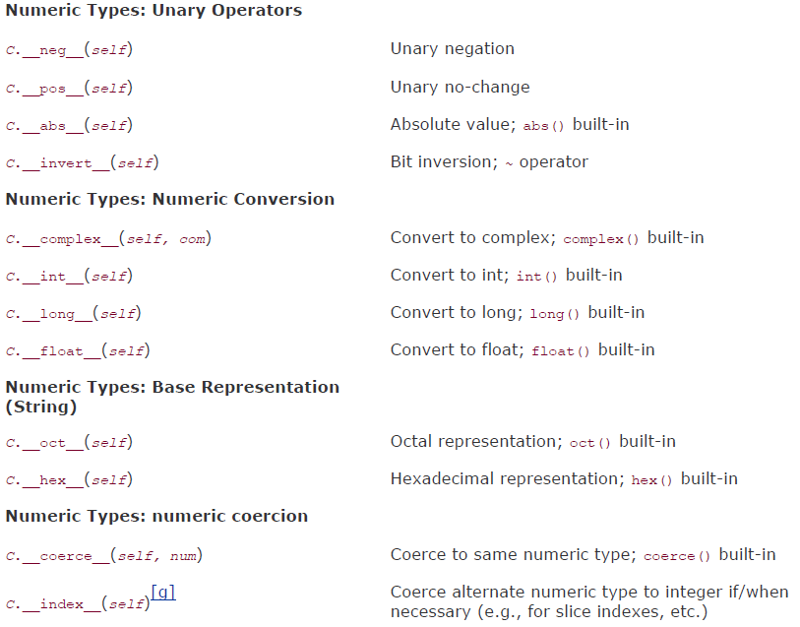
Grammar - Class
Special Methods for Customizing Classes (Cont.)

Slide 53
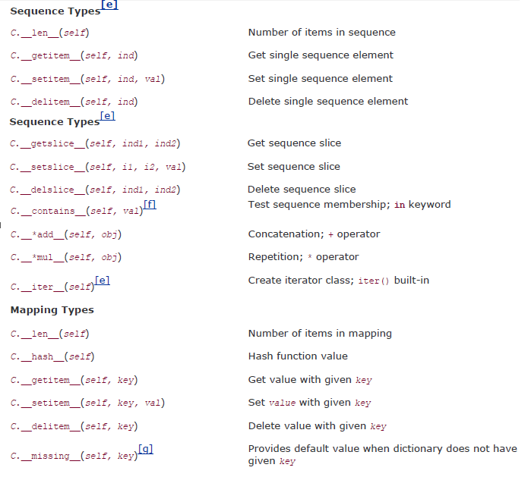
Grammar - Class

Slide 54
Grammar - Class
Delegation (wrapping)
The key to implement delegation is to override the __getattr__() method with code containing a call to the built-in getattr() function. Specifically, getattr() is invoked to obtain the default object attribute and return it for access or invocation
__getattr__() works, coz when an attribute is referenced, the Python interpreter will attempt to find that name in the local namespace, such as a customized method or local instance attribute. If it is not found in the local dictionary, then the class namespace is searched, just in case a class attribute was accessed. Finally, if both searches fail, the hunt begins to delegate the request to the original object, and that is when __getattr__() is invoked

Slide 55
Grammar - Class
Delegation example
Class WrapMe(object): def __init__(self, obj): self.__data__ = obj def get(self): return self.__data__ def __repr__(self): return ‘self.__data__’ def __str__(self): return str(self.__data__) def __getattr__(self, attr) return getattr(self.__data__, attr)
wrappedComplex = WrapMe(3.5 + 4.2j)
wrappedComplex => (3.5 + 4.2j)
wrappedComplex.real => 3.5
wrappedComplex.conjugate() => (3.5 – 4.2j)

Slide 56
Grammar - Advanced Features of New-Style Classes
__slots__ class attribute
Every instance has __dict__ property which will consume much memory especially when the instance is small
__slots__ is an alternative to __dict__ which is more compact. __slots__ is a class variable consisting of a sequence-like object representing the set of valid identifiers that make up all of an instance's attributes. This can be a list, tuple, or iterable. It can also be a single string identifying the single attribute that an instance can have.
Any attempt to create an instance attribute with a name not in __slots__ will result in an AttributeError exception
When __slots__ is defined for a class, __dict__ will not exist by default
Class SlottedClass(object): __slots__ = (‘foo’, ‘bar’) s = SlottedClass() s.xxx = ‘I don’t think so’ => exception thrown

Slide 57
Grammar - Advanced Features of New-Style Classes
__getattribute__()
It is always called when an attribute is accessed, not just when it cannot be found (not like __getattr__())
If a class has both __getattribute__() and __getattr__() defined, the latter will not be called unless explicitly called from __getattribute__() or if __getattribute__() raises AttributeError
To avoid infinite recursion using this method, you should always call an ancestor class method that shares the same name in order to access any attributes it needs safely; for example, super(obj, self). __getattribute__(attr)

Slide 58
Grammar - Advanced Features of New-Style Classes
Descriptors
Think of a descriptor as an agent that presents object attributes. It is any (new-style) class that implements at least one of three special methods that serve as the descriptor protocol: __get__(), __set__(), and __delete__()
Descriptors which do not implement __set()__ are referred method descriptors, or non-data descriptors. Those that override both __get__() and __set__() are called data descriptors
The signatures def __get__(self, obj, typ=None) => value def __set__(self, obj, val) => None def __delete__(self, obj) => None
Given a class X and an instance x, x.foo is translated to type(x).__dict__['foo'].__get__(x, type(x)). If __get__() is called for a class, then None is passed in as the object (which would be self for an instance): X.__dict__['foo'].__get__(None, X)

Slide 59
Grammar - Advanced Features of New-Style Classes
Precedence (when accessing attributes)
Class attributes
Data descriptors
Instance attributes
Non-data descriptors
Defaulting to __getattr__()
Static methods, class methods, properties and even functions themselves are all descriptors
Descriptor example

Slide 60
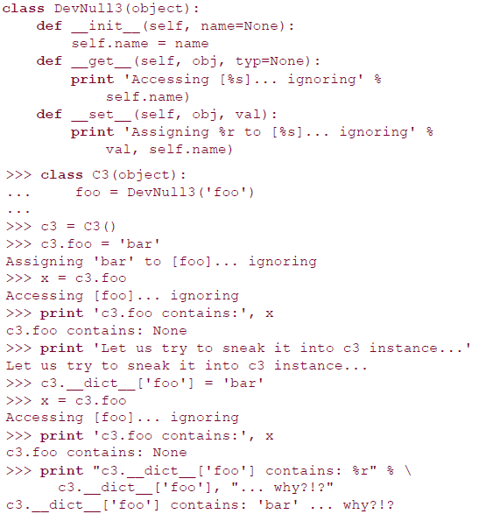
Notice how we were able to sneak in an attribute to our instance. We were able to assign the string "bar" to c3.foo, but because the data descriptor is more important, it overrides or effectively hides our assignment.

Slide 61
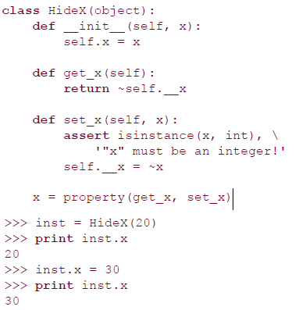
Grammar - Advanced Features of New-Style Classes
Properties and property() built-in
Properties are a very useful and specific type of descriptor were meant to handle all accesses to instance attributes in a similar manner as descriptors
property(fget=None, fset=None, fdel=None, doc=None), instance-method-eg

Slide 62
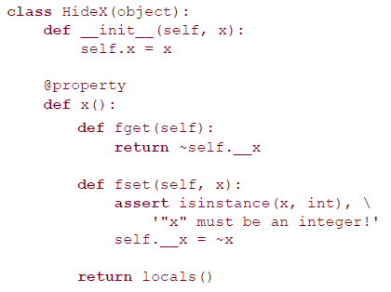
Grammar - Advanced Features of New-Style Classes
property() function example
from math import pi def get_pi(dummy): # dummy variable is a placeholder of self return pi class PI(object): pi = property(get_pi, doc='Constant "pi"')
Hide X

Slide 63
Grammar - Advanced Features of New-Style Classes
Metaclass and __metaclass__
Metaclass is class which creates other class (its instance is other class)
When executing a class definition, the interpreter has to know the correct metaclass to use. It will look for a class attribute named __metaclass__ first, and if it is there, it will use the class that is assigned to that attribute as the metaclass
If that attribute has not been defined, it will go up and search an ancestor class for __metaclass__. All new-style classes must inherit from object or type if there are no other base classes
If that is not found, it checks for a global variable named __metaclass__ and uses it if it exists.
Otherwise, the class is a classic class, and types.ClassType is used as the metaclass
metaclass (always) passes three arguments (to its constructor): the class name, the tuple of base classes to inherit from, and the (class) attribute dictionary (Python interpreter will figure out the arguments and passes in them automatically)

Slide 64
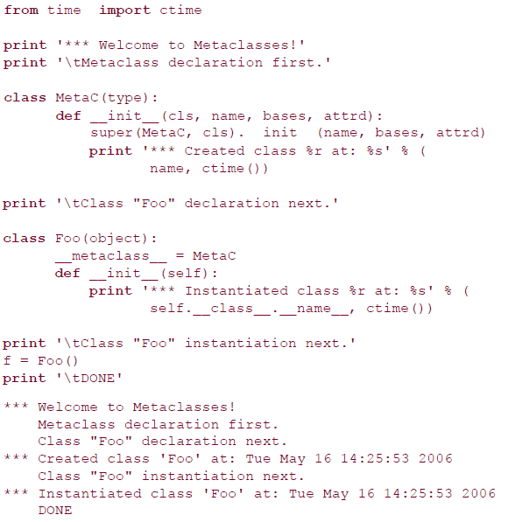
Grammar - Advanced Features of New-Style Classes

Slide 65
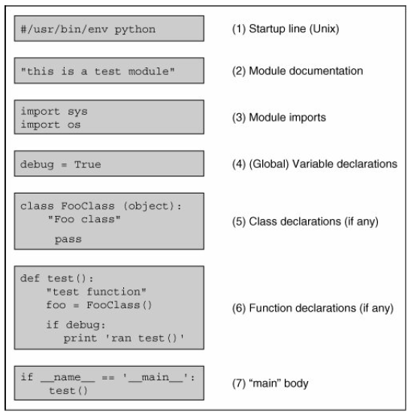
Module structure
Module structure

Slide 66
Module - Main
How the code is executed
All Python statements in the highest level of code that is, the lines that are not indentedwill be executed on import , whether desired or not. Because of this "feature," safer code is written such that everything is in a function except for the code that should be executed on an import of a module
__name__ indicates how module was loaded
__name__ contains module name if imported
__name__ contains '__main__' if executed directly from command line

Slide 67
Module
Module import
import module1[, module2,…]
from module import name1[,name2,…]
from module import (name1, name2,…)
from module import longname as shortname
import - search path
PYTHONPATH env variable (colon-delimited set of directory paths)
sys.path (can change it in run-time by calling ‘append’)
sys.modules contains where the imported module come from
We can use the globals() and locals() built-in functions to tell us which names are in which namespaces when a function is called
A module is loaded only once, regardless of the number of times it is imported preventing the module "execution" from happening over and over again if multiple imports occur

Slide 68
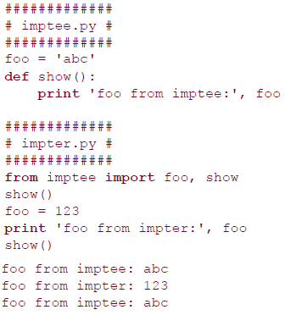
Module
Names Imported
Calling from-import brings the name into the current namespace
The imported names are now part of the local namespace. A side effect is possibly hiding or overriding an existing object or built-in with the same name. Also, changes to the variable affect only the local copy and not the original in the imported module's namespace. In other words, the binding is now local rather than across namespaces.

Slide 69
Module
Can add import hooks while importing (register against sys module)
__import__ built-in
__import__(module_name[, globals[, locals[, fromlist]]])
globals()/locals()
The globals() and locals() built-in functions return dictionaries of the global and local namespaces, respectively, of the caller. From the global namespace, however, globals() and locals() return the same dictionary
reload
reload(module), use module as the parameter not the module name
All attributes prefixed with ‘_’ of the module will not be imported with ‘from module import *’ directive

Slide 70
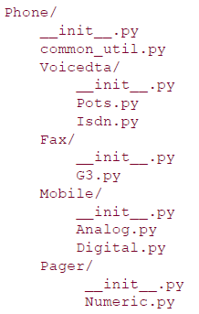
Package
Package
Like classes and modules, packages use the familiar attribute/dotted attribute notation to access their elements
Every subdir in package should contain a __init__.py which will be called automatically while importing

Slide 71
Package
Package import
from package.module import *
__all__ variable (which consists a list of module names) in __init__.py is required for the above import which indicates which modules should be imported
Absolute Import
Package modules will hide any equivalently-named standard library module.
Because of this, all imports are now classified as absolute, meaning that names must be packages modules accessible via the Python path (sys.path or PYTHONPATH)
Relative Import
only apply to from-import statements. The first part of the syntax is a leader dot to indicate a relative import. From there, any additional dot represents a single level above the current from where to start looking for the modules being imported, say “from ..common_util import setup”

Slide 72
Memory mgmt
Memory mgmt details
Variables not declared ahead of time
Variable types not declared
No memory management on programmers' part
All objects are mgmted by reference count
Variable names can be "recycled“ after reference count drops to zero
del statement allows for explicit "deallocation“
Object ids (memory addr)
>>> a = 4
>>> b = a
>>> id(a)
36939444
>>> id(b)
36939444

Slide 73
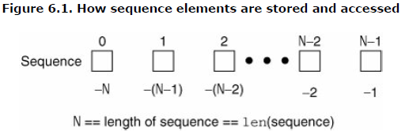
Sequences
String, List, Tuple are sequences
Membership: in, not in obj [not] in sequence
Concatenation: + sequence1 + sequence2
Repetition: * sequence * copies_int
Slices: [ ], [ : ], [ : : ]
How sequences are stored and accessed ?

Slide 74
Strings
Manipulation of strings
aString = “hello world”
aString[0]
aString[1:5]
aString[6:]
aString[-1] (from the end to the begginning)
aString[:] (complete slice)
aString = aString[:6] + ‘Python’ (substr + concat)
aString = aString[:3] + aString[4:] (delete one char)
‘bc’ in ‘abcd’
‘nm’ not in ‘abcd’
‘hello’ + u’abcd’ (convert ‘hello’ to unicode string automatically)
who * 2 (repetition)
Ur’hello\nworld’ (raw unicode string)
dir(str)

Slide 75
Strings (Cont.)
Manipulation of strings
aString = “hello world”
aString[0]
aString[1:5]
aString[6:]
aString[-1] (from the end to the begginning)
aString[:] (complete slice)
aString = aString[:6] + ‘Python’ (substr + concat)
aString = aString[:3] + aString[4:] (delete one char)
‘bc’ in ‘abcd’
‘nm’ not in ‘abcd’
‘hello’ + u’abcd’ (convert ‘hello’ to unicode string automatically)
who * 2 (repetition)
Ur’hello\nworld’ (raw unicode string)

Slide 76
Strings (Cont.)
Triple quotes allows the string to span multiple lines, including verbatim NEWLINEs, tabs, and any other special characters
>>> aStr = '''hello
world'''
>>> aStr
'hello\nworld‘
errHTML = ‘’’
<HTML><HEAD><TITLE>
Friends CGI Demo</TITLE></HEAD>
<BODY><H3>ERROR</H3>
<B>%s</B><P>
<FORM><INPUT TYPE=button VALUE=Back
ONCLICK="window.history.back()"></FORM>
</BODY></HTML>
'‘’

Slide 77
Strings (Cont.)
String Format Operator ( % ) Provides printf()-like Functionality
>>>’%f’ %123.456
Python Strings Do Not End with NUL or '\0‘ (in C language)
Unicode
hi = u“hello world”
bytes_out = hi.encode(‘utf-8’)
bytes_in = bytes_out
hi = bytes_in.decode(‘utf-8’)
Get help
>>>help(str)
>>>dir(str)
Lots of built-in functions

Slide 78
Lists
Manipulation of Lists
aList = [1, 2, [3, 4], 5, ‘hello world’]
anotherList = list(“foo”) => ['f', 'o', 'o']
aList[2][1] => 4
aList[1:]
aList[:4]
[3, 4] in aList
‘hello’ not in aList
aList += [6, 7]
anotherList *= 2 => ['f', 'o', 'o‘, 'f', 'o', 'o']
dir(list)

Slide 79
Lists (Cont.)
Comparison of two lists (the algorithm)
Compare elements of both lists
If elements are of the same type, perform the compare and return the result
If elements are different types, check to see if they are numbers
If numbers, perform numeric coercion if necessary and compare
If either element is a number, then the other element is "larger" (numbers are "smallest")
Otherwise, types are sorted alphabetically by name
If we reach the end of one of the lists, the longer list is "larger.“
If we exhaust both lists and share the same data, the result is a tie, meaning that 0 is returned

Slide 80
Lists (Cont.)
List comprehension
[expr for iter_var in iterable] [x**2 for x in range(6) => [0, 1, 4, 9, 16, 25] sum([len(word) for line in f for word in line.splilt()])
[expr for iter_var in iterable if cond_expr] [x for x in range(100) if x%2] => [1, 3, 5, …, 99] [(x+1, y+1) for x in range(3) for y in range(5)]
Generator expressions
(expr for iter_var in iterable if cond_expr)
List comprehension need load all data to create the while list which will be a problem for large data
Instead of building a list with values, Generator expressions return a generator that "yields" after processing each item. Generator expressions are much more memory efficient by performing "lazy evaluation."

Slide 81
Lists (Cont.)
Generator expressions, example
sum(len(word) for line in f for word in line.splilt())
max(len(x.strip()) for x in open(‘/etc/motd’)

Slide 82
tuple
Tuple
extremely similar in nature to lists
tuples use parentheses ‘()’ to define, but list use brackets ‘[]’
Tuple is immutable, but list is mutable. Note the tuple itself can’t be changed, but its elements can if the element is mutable (i.e. the element is not string, number, or tuple of number, tuple of string etc)
Creation of tuple
emptiestPossibleTupe = (None, ) # note the trailing ‘,’
tuple(‘bar’) => (‘b’, ‘a’, ‘r’)
Any set of multiple objects, comma-separated, written without identifying symbols, i.e., brackets for lists, parentheses for tuples, etc., defaults to tuples

Slide 83
tuple
Manipulation of Tuple
t = ([‘xyz’, 123], 23, -103)
t * 2
t + (‘free’, ‘easy’)
23 in t => True
123 in t => False
t[1:]
len(t)
max(t)
min(t)
list(t) => convert tuple to list
dir(tuple)

Slide 84
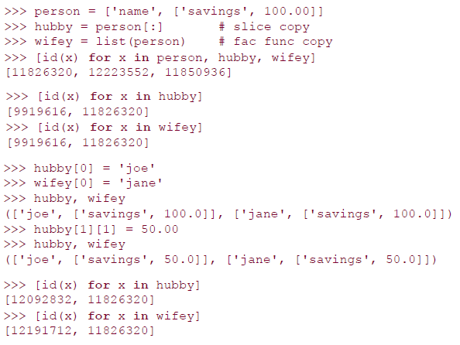
Deep/shadow copy
Deep copy is only meaningful to mutable variable type
Shadow copy is achieved by ‘complete slice’
Shadow copy example

Slide 85
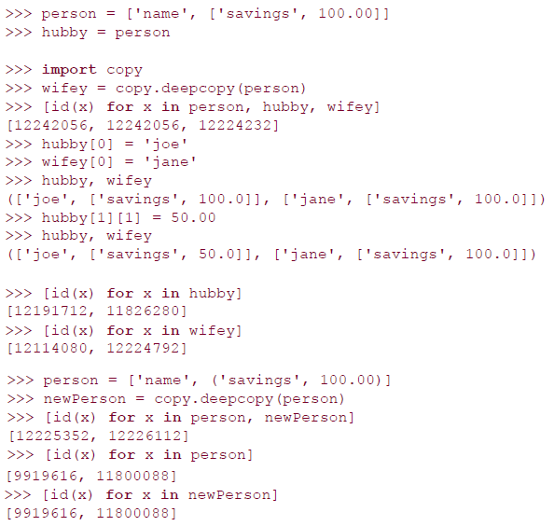
Deep/shadow copy
Deep copy example

Slide 86
dictionary
Manipulation/definition of dictionary
dict1 = {}
dict2 = {‘name’: ‘earth’, ‘port’: 80}
fdict = dict([‘x’, 1], [‘y’, 2]) => (‘y’: 2, ‘x’: 1)
ddict = {}.fromkeys((‘x’, ‘y’), -1) => (‘y’: -1, ‘x’: -1)
edict = {}.fromkeys((‘foo’, ‘bar’)) => (‘foo’: None, ‘bar’: None)
for key in dict2: print ‘key = %s, value = %s’ %(key, dict2[key])
‘server’ in dict2 => False
dict2[‘server’] = ‘apache’ # add key-value
dict2[‘port’] = 8080 # update value
del dict2[‘name’] # delete key-value
dict2.pop(‘port’) # delete and return item which have key ‘port’
dict2.clear() # delete all key-values
dir(dict)

Slide 87
set
Manipulation/definition of dictionary
Set can only be created thr built-in set() and frozenset()
s = set('cheeseshop') => set(['c', 'e', 'h', 'o', 'p', 's'])
t = frozenset('bookshop')
s == t => False
‘k’ in s => False
'c' not in t => True
s.add('z')
s.update('pypi')
s.remove('z')
s -= set('pypi')
dir(set)

Slide 88
File and I/O
Built-in Functions
fileObject = open(fileName, accesMode = ‘r’, buffering = -1)
‘b’ for binary mode
file() factory method, same function as “open”. when handling file object, file will be useful, say “if instance(f, file)”
Input
read(), readline(), readlines(), xreadlines()
for eachLine in f:
Output
write(), writelines()
OS module
linesep/sep/pathsep/curdir/pardir

Slide 89
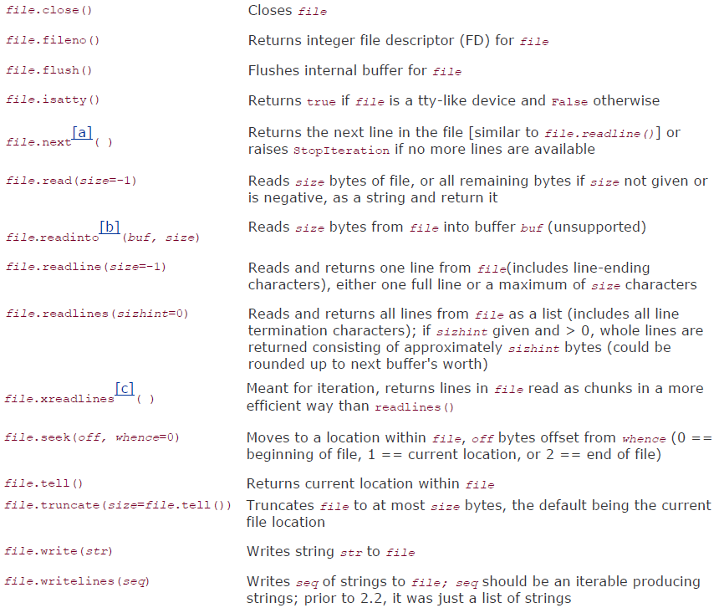
Methods for File Objects

Slide 90
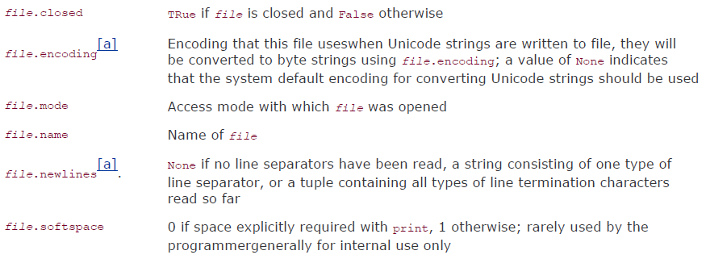
Attributes for File Objects

Slide 91
Standard files
Standard files
sys.stdin, sys.stdout, sys.stderr
Cmd line args
sys.argv, len(sys.argv) – argc
getopt/optparse to handle parsing cmd line args

Slide 92
File I/O
Standard files
sys.stdin, sys.stdout, sys.stderr
Cmd line args
sys.argv, len(sys.argv) – argc
getopt/optparse to handle parsing cmd line args

Slide 93
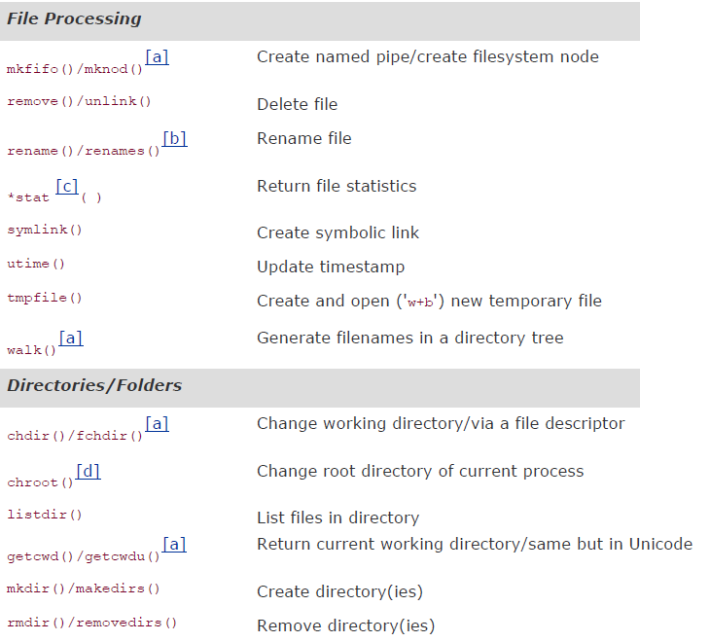
File system interface

Slide 94
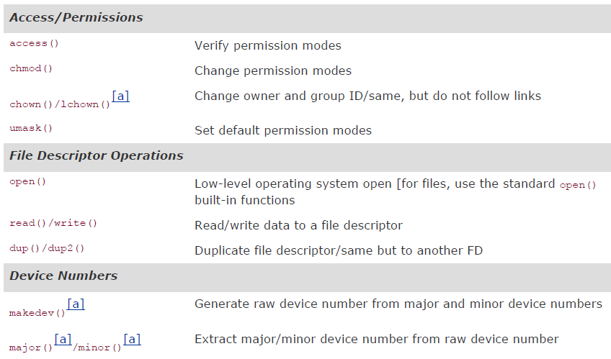
File system interface

Slide 95
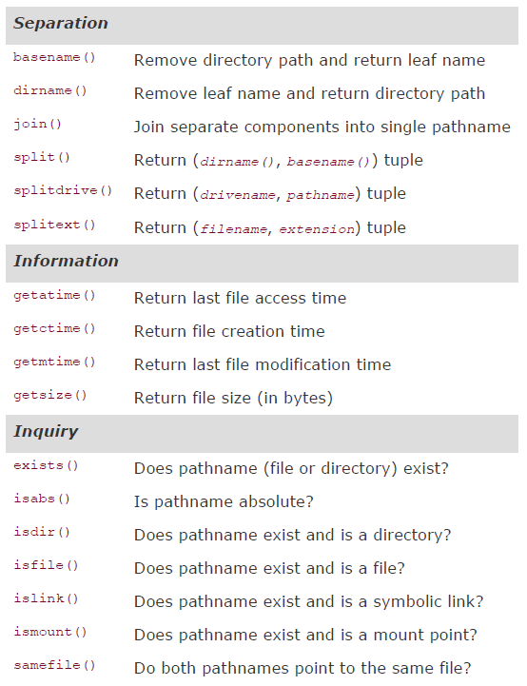
OS path module

Slide 96
Persistent storage module
marshal
Only handle simple object(number, sequence, map, code object)
pickle
Marshal + recursive object, multi-referenced object in different places
DBM style module
anydbm which will search and direct the request to the best DBM implementation (dbhash/bsddb, dbm, gdbm, dumbdbm etc)
Shelve
Use anydbm to locate a suitableDBM module, and then use cPickle to perform the pickling process
Permits concurrent read access to the database file, but not shared read/write access

Slide 97
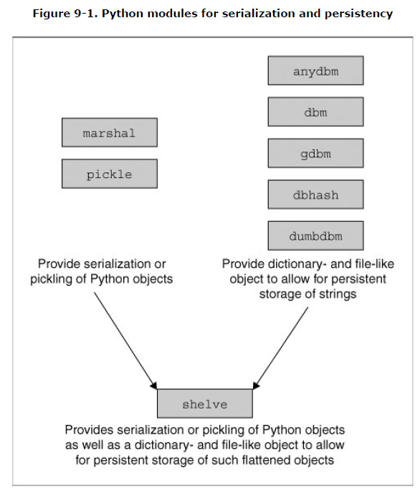
Persistent storage module

Slide 98
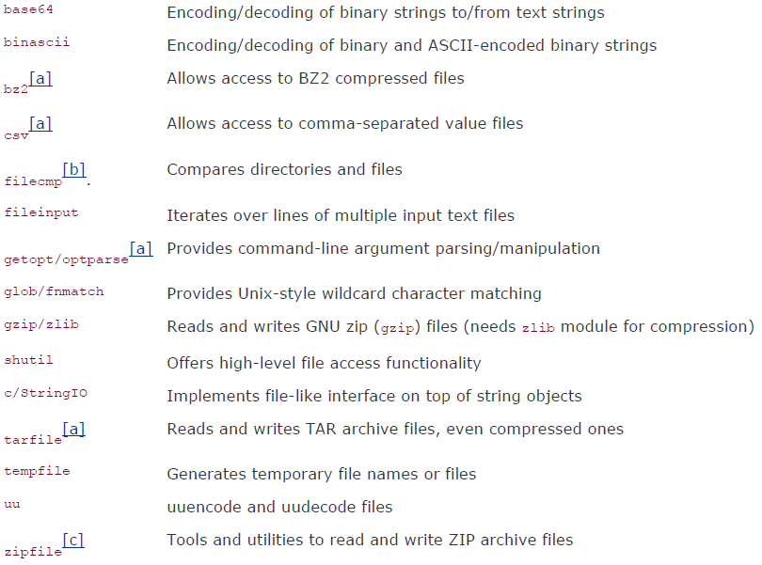
Related file modules

Slide 99
Execution env
Callable objects
BIF (Built-in function)
UDF (User-defined function)
Lambda
BIM (Built-in method)
UDM (User-defined, method)
Class instances instantiated from classes which has defined __call__ special method
Code object
byte-compiled code (byte code) converted from Python code
They do not contain any information about their execution environment, and that is why callables exist, to "wrap" a code object and provide that extra information

Slide 100
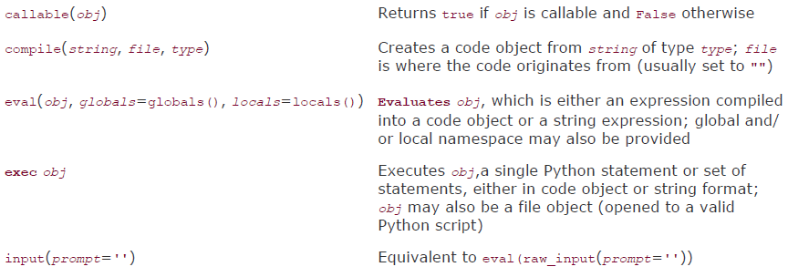
Executable Object Statements and Built-in Functions

Slide 101
Execute other python program
Import
Import executes the module
execfile()
execfile(filename, globals=globals(), locals=locals())
Executing Modules as Scripts
python -m CGIHTTPServer

Slide 102
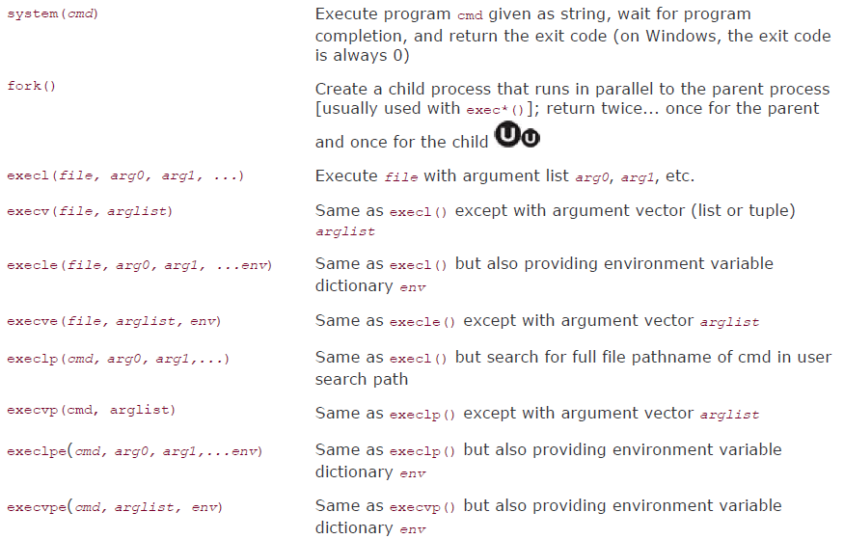
Execute other program (os Module)

Slide 103
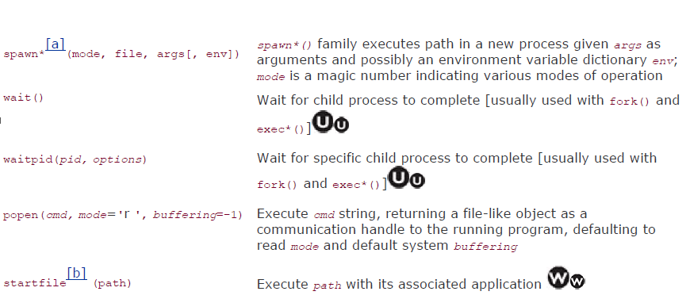
Execute other program

Slide 104
Terminating execution
sys.exit()
Throws SystemExit exception which is the only exception that not viewed as an error.
sys.exitfunc()
Is disabled by default, but can be overridden to provide additional functionality, which takes place when sys.exit() is called and before the interpreter exits
This function will not be passed any arguments import sys prev_exit_func = getattr(sys, 'exitfunc', None) def my_exit_func(old_exit = prev_exit_func): # perform cleanup if old_exit is not None and callable(old_exit): old_exit() sys.exitfunc = my_exit_func
os._exit(), os.kill()

Slide 105
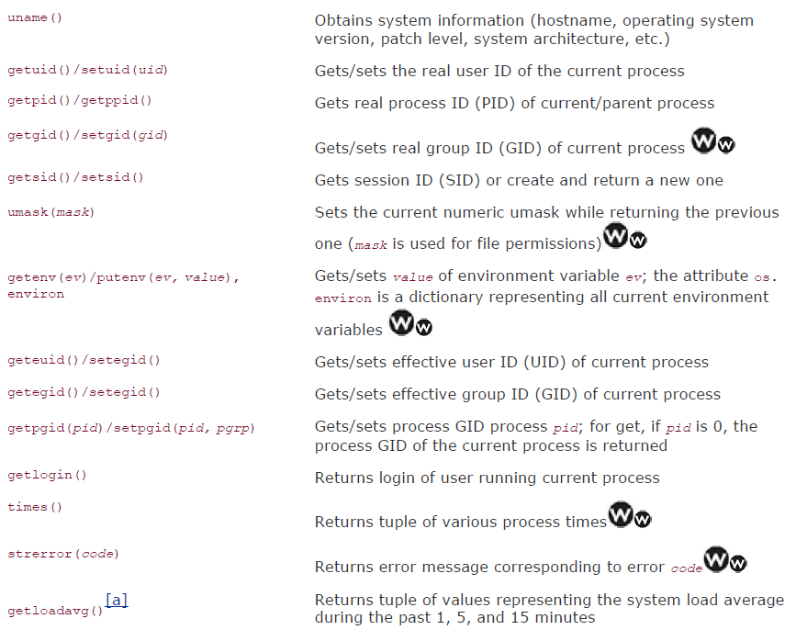
Os interface

Slide 106
Advance topics

Slide 107
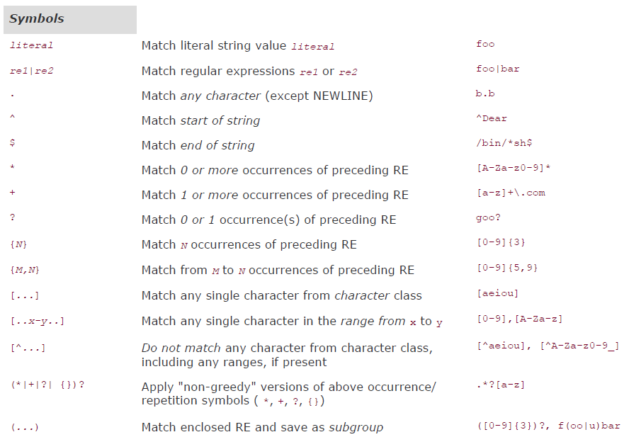
Regular expression

Slide 108
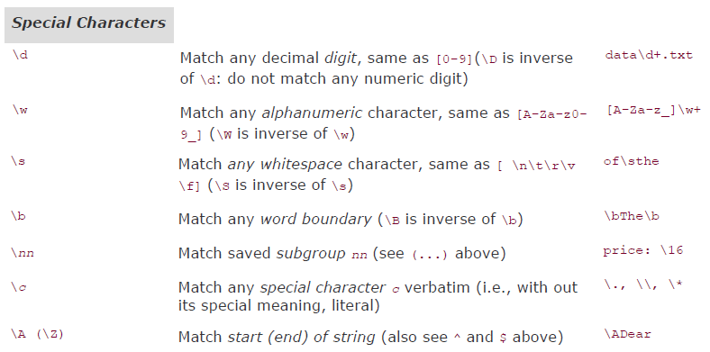
Regular expression

Slide 109
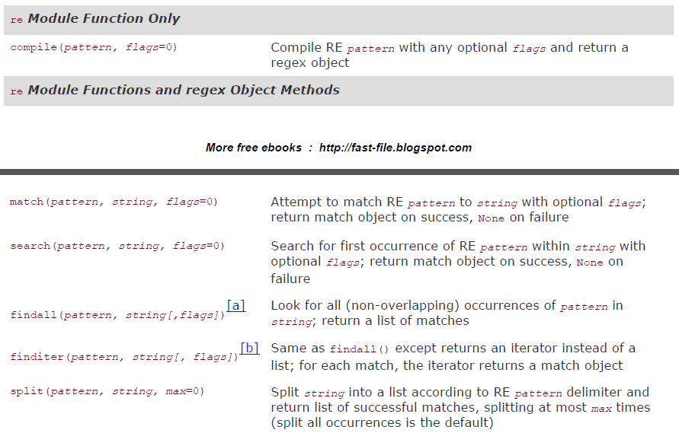
re module

Slide 110
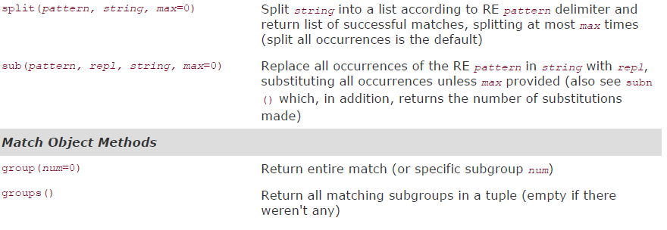
re module

Slide 111
Regular expression
Greedy and non-greedy mode
patt1 = '.+(\d+-\d+-\d+)’ # Greedy by default
patt2= '.+?(\d+-\d+-\d+)‘ # “?” tell the RE engine non-greedy data = ‘Thu Feb 15 17:46:04 2007::uzifzf@dp.gov::1171590364-6-8 re.match(patt1, data).group(1) => 4-6-8 re.match(patt2, data).group(1) => 1171590364-6-8

Slide 112
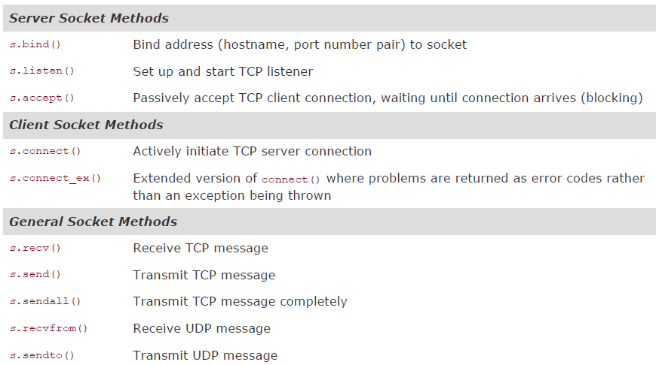
Network programming
socket module
sockObject = socket.socket(socket_family, socket_type, protocol=0)

Slide 113
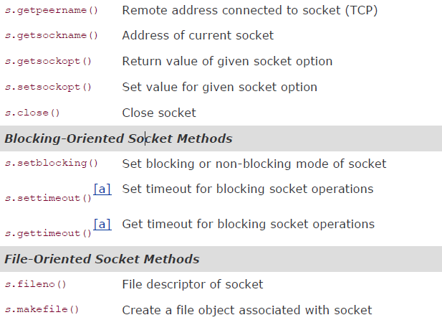
Socket module (cont.)

Slide 114
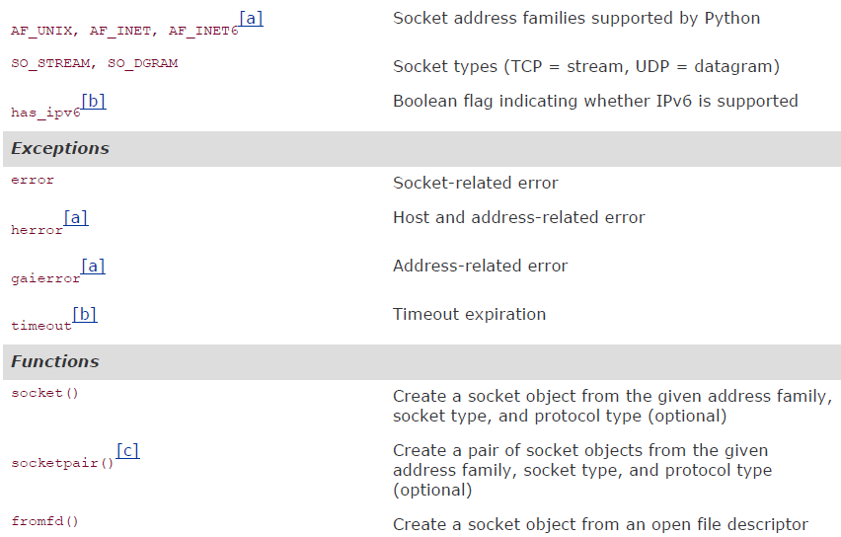
Socket module attributes

Slide 115
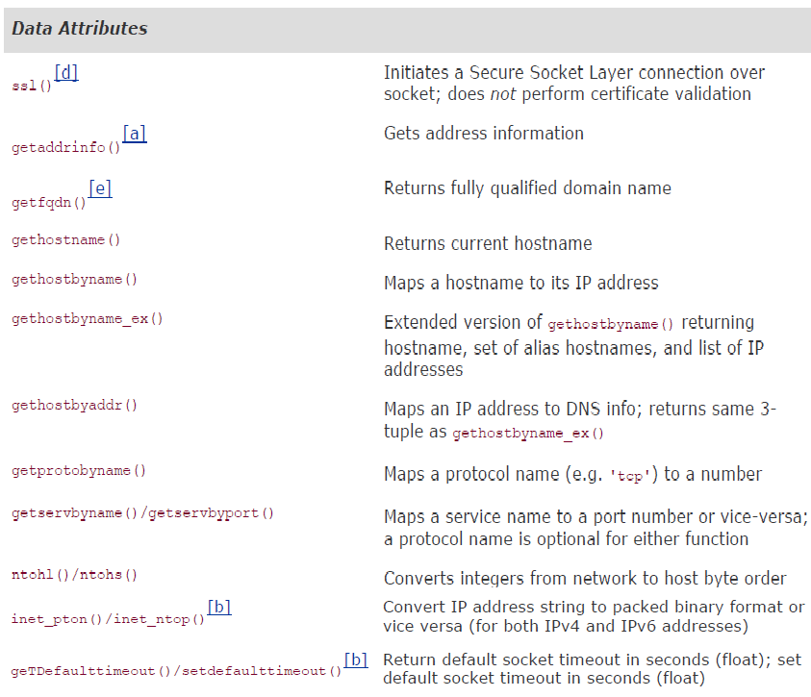
Socket module attributes (cont.)

Slide 116
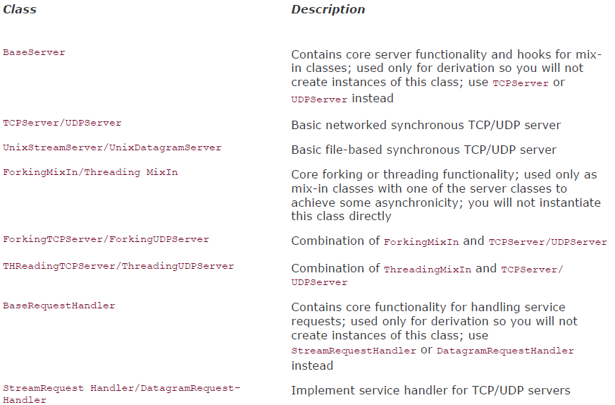
SocketServer Module

Slide 117
Internet Client programming
ftplib.FTP
nntplib.NNTP
smtplib.SMTP
poplib.POP3
telnetlib
Httplib
gopherlib

Slide 118
Multi-thread programming
Global Interpreter Lock (GIL)
Execution of Python code is controlled by the Python Virtual Machine (aka the interpreter main loop). Python was designed in such a way that only one thread of control may be executing in this main loop
Access to the Python Virtual Machine is controlled by the global interpreter lock (GIL). This lock is what ensures that exactly one thread is running.
The PVM execs in the following manner in a MT env
Set the GIL
Switch in a thread to run
Execute either ... a) For a specified number of bytecode instructions, or b) If the thread voluntarily yields control (can be accomplished by time.sleep(0))
Put the thread back to sleep (switch out thread)
Unlock the GIL, and ...
Do it all over again (lather, rinse, repeat)

Slide 119
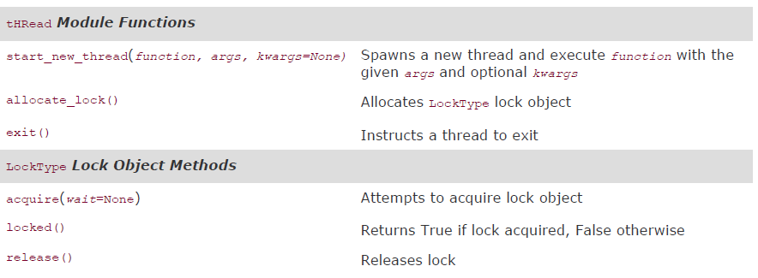
thread module (low level)

Slide 120
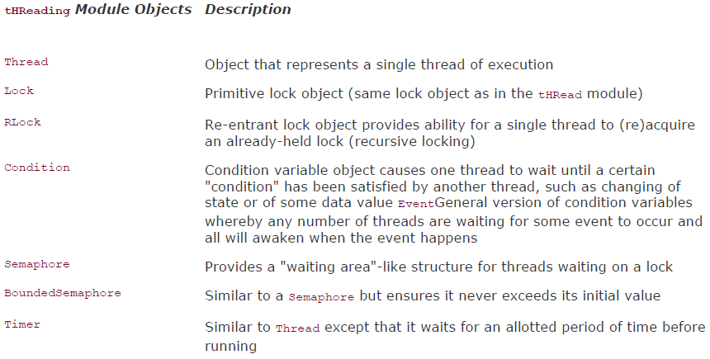
threading module (high level)

Slide 121
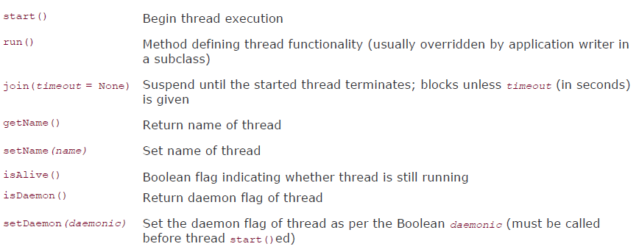
threading module (Thread method)

Slide 122
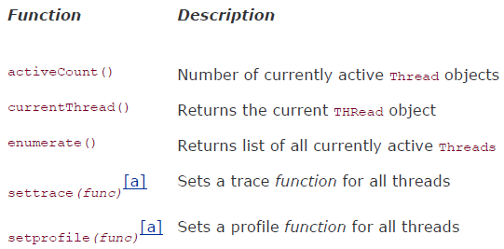
threading module (Other functions)

Slide 123
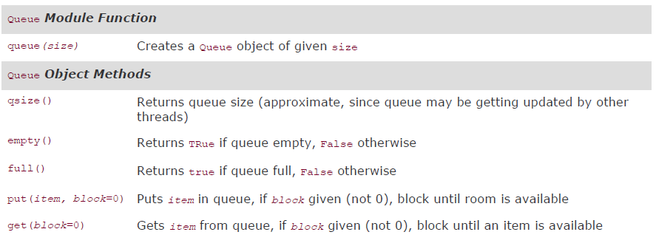
Queue module

Slide 124

Web programming
urlparse module

Slide 125

Web programming
urllib module (more powerful urllib2)

Slide 126

Web programming
urllib.urlopen file object methods

Slide 127

Database programming
Database and Python

Slide 128

Database programming
DB-API module attributes
Thread Safety
0: Not thread safe, so threads should not share the module at all
1: Minimally thread safe: threads can share the module but not connections
2: Moderately thread safe: threads can share the module and connections but not cursors
3: Fully thread safe: threads can share the module, connections, and cursors

Slide 129

Database programming
Paramstyle

Slide 130

Database programming
DB-API exceptions

Slide 131

Database programming
connection object

Slide 132

Database programming
Cursor object

Slide 133

Database programming
Curosr object (cont.)

Slide 134

Database programming
Type Objects and Constructors

Slide 135
Database programming
Modules
MySQLdb
psycopg/pyPgSQL/pgdb
Sqlite3
gadfly
cx_Oracle
etc

Slide 136
Extending Python
Steps
Create a C module, xxx.c
Wrap Your Code in Boilerplate
Include Python header file
Add PyObject* Module_func() Python wrappers for each module function
Add PyMethodDef Module Methods[] array/table for each module function
Add void init Module() module initializer function
Compile
Create setup.py
python setup.py build
python setup.py install
Import and testing

Slide 137


Extending Python
Data conversion between Python and C/C++

Slide 138
Extending Python
Example # Extest.c #include <stdlib.h> int fac(int n) { if (n < 2) return (1); return (n) * fac(n-1); } #include “python.h” static PyObject* Extest_fac(PyObject *self, PyObject *args) { int num = 0; if (!PyArg_ParseTuple(args, “I”, &num)) return NULL; return (PyObject*) Py_BuildValue(“i”, fac(num)); } static PyMethodDef ExtestMethods[] = { {“fac”, Extest_fac, METH_VARGARGS}, {NULL, NULL}, }; void initExtest() { Py_InitModule(“Extest”, ExtestMethods); }

Slide 139
Miscellaneous
Win32 module deals with MS Office
win32com.client
Excel/Word/PowerPoint/Outlook
Jython deals with Java and Python

